Slide 1
UNVEILING PROCESSOR EXCELLENCE: A COMPARATIVE STUDY OF INTEL CORE AND AMD RYZEN
---Prof. Habib Senol
TEAM MEMBERS:
Abhijith Gentela
Hemanth Sai Pothuru
Akhil Polsani

Slide 2
Table of Contents
1. Introduction
2. Historical Development of Processors
3. INTEL Processor Architecture
4. AMD Ryzen Processor Architecture
5. Comparison of Intel Core and AMD Ryzen Processor Architecture
6. Methodology
7. Benchmarks of Intel core VS AMD Ryzen
In-Depth Benchmark Analysis
8. Intel Core vs. AMD Ryzen: A Comparative Analysis
9. Energy Efficiency
10. User preference and market
11. Future Improvements
12. Conclusion
13. References

Slide 3
Introduction
Processors serve as the backbone of computational devices, wielding substantial influence over performance, efficiency, and the breadth of applications they can handle.
A comparative analysis between Intel Core and AMD Ryzen bridges theoretical understanding with real-world performance, providing essential insights for users, industry professionals, and researchers.
The purpose is to assess essential parameters processing speed, energy efficiency, scalability, and microarchitectural innovations of Intel Core and AMD Ryzen utilizing benchmarking, and architectural analysis.
The structure encompasses sections on historical development, methodology, processor architecture, processing speed, energy efficiency, scalability, microarchitectural innovations, and comparative analysis.

Slide 4
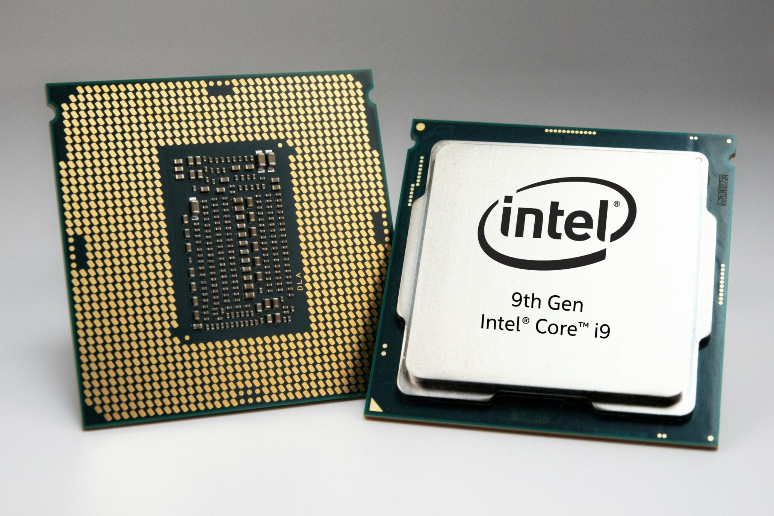
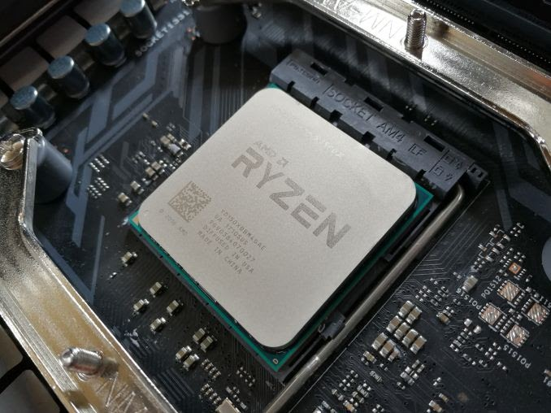
Historical Development of Processors
Intel History Overview:
Founded in 1968, Intel revolutionized computing with its x86 architecture and Pentium processors.
The Core series, launched in 2006, marked significant advancements in power and efficiency.
AMD Ryzen History Overview:
Established in 1969, AMD was often overshadowed by Intel until a major turnaround with Ryzen in 2017.
Successive Ryzen generations Zen+, Zen 2, and the latest Zen 3 architectures, have continued to enhance performance, efficiency, and competitiveness against Intel.
INTEL CORE
AMD RYZEN CORE

Slide 5
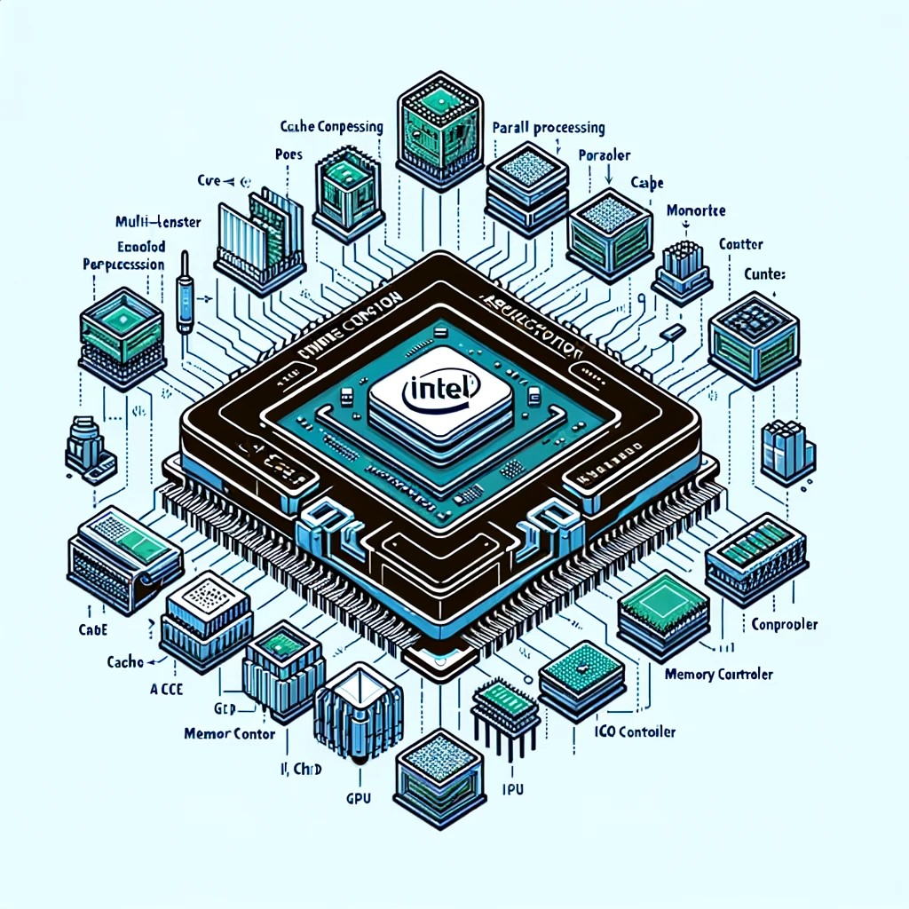
INTEL Processor Architecture
Intel Core processors, based on the x86-64 ISA, feature a complex CISC architecture, evolved over decades. The latest Alder Lake series introduces a hybrid design combining high-performance and efficient cores, optimizing both power efficiency and performance. Key components include:
Multiple Cores: Enable parallel processing for enhanced performance.
Cache: Multi-level, high-speed memory for quick data access.
Memory Controller: Manages CPU-main memory communication.
I/O Controller: Facilitates data transfer with peripherals.
Integrated GPU: Offers basic graphics processing in some models.
INTEL CORE processor

Slide 6
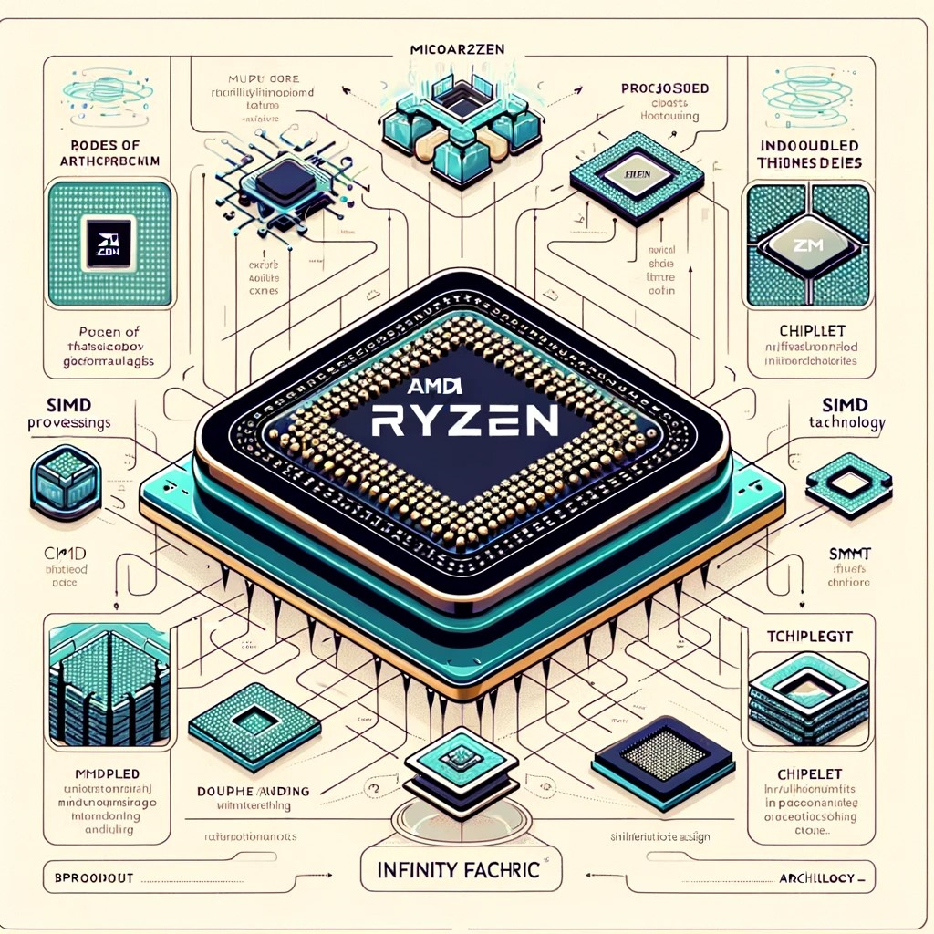
AMD Ryzen Processor Architecture
AMD Ryzen processors, built on the x86-64 ISA, feature the Zen microarchitecture tailored for high performance and efficiency. Distinct aspects of Ryzen architecture include:
Increased Core Count: Offers more cores for better multitasking and multithreaded performance.
SIMD (Single Instruction, Multiple Data): Enhances performance for tasks that process multiple data elements simultaneously.
SMT (Simultaneous Multithreading): Each core can execute two threads at once, improving throughput.
Chiplet Design: Uses interconnected smaller dies for a modular and cost-efficient build.
Infinity Fabric: A high-speed interconnect that links the chiplets for fast data transfer.
AMD RYZEN CORE processor

Slide 7
Comparison of Intel Core and AMD Ryzen Processor Architecture
Feature | Intel Core | AMD Ryzen
Instruction Set Architecture (ISA) | x86-64 | x86-64
Microarchitecture | Alder Lake | Zen
Core Design | Hybrid (P-cores and E-cores) | Monolithic
SIMD | Supported | Supported
SMT | Supported | Supported
Chiplet Design | No | Yes
Interconnect | Ring Bus | Infinity Fabric
TABLE: Comparison of Intel Core and AMD Ryzen Processor Architecture

Slide 8
Comparison of Intel Core and AMD Ryzen Processor Architecture (Cont)
ISA Similarity: Both Intel Core and AMD Ryzen use the x86-64 ISA, ensuring software compatibility.
Microarchitecture: Intel's Alder Lake is a hybrid of performance and efficiency cores, while AMD's Zen focuses on multithreading.
Core Design: Intel uses a mix of P-cores and E-cores; AMD uses uniform cores for consistent performance.
SIMD Support: Both processor lines improve task-specific performance with SIMD instructions.
SMT Technology: Intel and AMD both support simultaneous multithreading for increased processing capability.
Structure Design: Intel favors a monolithic design, whereas AMD opts for a flexible, cost-effective chiplet design.
Interconnects: Intel employs Ring Bus, and AMD uses Infinity Fabric for component communication within the processor.
Performance Considerations: Intel shines in single-threaded tasks; AMD offers superior multithreaded performance.

Slide 9
Methodology
Evaluation includes performance metrics (clock speed, core count, cache, TDP), architectural aspects, cost-efficiency, market position, considering Intel Core and AMD Ryzen processors.
Standard benchmarks (Cinebench, Geekbench, SPEC CPU, PassMark) assess single/multi-core performance, FLOPS, IPC, memory. Monitoring tools observe power, thermal behavior, and energy efficiency.
Study simulates gaming, content creation, productivity, parallel processing, stress tests to evaluate processor performance, stability, thermal management across workloads.
Performance metrics, power usage, temperature are gathered with user feedback and software compatibility. Statistical analyses validate relationships and findings.

Slide 10
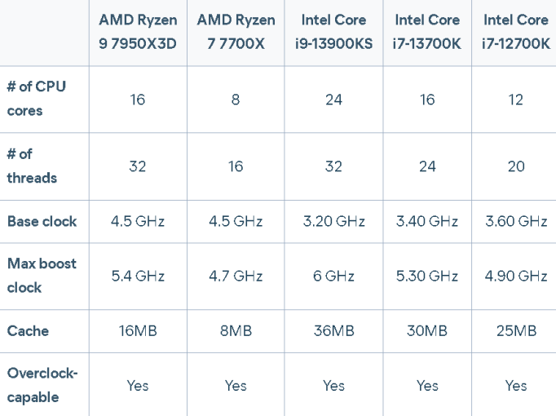
Methodology (Cont)
Evaluation includes performance metrics

Slide 11
Benchmarks of Intel core VS AMD Ryzen In-Depth Benchmark Analysis
Benchmarks serve as standardized tools to evaluate CPU performance.
Various benchmarks exist, with some of the most widely recognized ones including:
Cinebench.
Geekbench.
3DMark.

Slide 12
Benchmarks of Intel core VS AMD Ryzen In-Depth Benchmark Analysis (Cont)
Cinebench:
Cinebench is a benchmark that assesses CPU performance in rendering and 3D applications. It measures how quickly a processor can render complex 3D scenes and perform other computationally intensive tasks.
Geekbench 5:
Geekbench is a benchmark that measures CPU performance in both single-threaded and multi-threaded tasks. It gauges how quickly a processor can handle single-core operations like web browsing and multi-core operations like video editing.
3DMark Time Spy and Fire Strike:
3DMark Time Spy and Fire Strike are synthetic benchmarks that measure the graphics performance of a system.

Slide 13
Benchmarks of Intel core VS AMD Ryzen In-Depth Benchmark Analysis (Cont)
CPU | Cinebench R23 Multi-Core | Cinebench R23 Single-Core | Geekbench 5 Multi-Core | Geekbench 5 Single-Core | 3DMark Time Spy | 3DMark Fire Strike
Ryzen 9 7950X3D | 32000 | 1900 | 18000 | 2100 | 13000 | 21000
Core i9-13900KS | 33000 | 2000 | 19000 | 2150 | 14000 | 22000
Core i7-13700K | 27000 | 1900 | 17500 | 2050 | 13000 | 21000
Ryzen 7 5800X3D | 27000 | 1850 | 16000 | 1950 | 11000 | 19000
Ryzen 5 7600X | 20000 | 1750 | 13000 | 1850 | 9000 | 17000
Intel Core i5-13600K | 19000 | 1800 | 12500 | 1800 | 8500 | 16500
Benchmarks of Intel core vs AMD Ryzen in multiple wesites

Slide 14
Benchmarks of Intel core VS AMD Ryzen In-Depth Benchmark Analysis (Cont)
As you can see, the Ryzen 9 7950X3D and the Core i9-13900KS are very close in terms of performance. The Ryzen 9 7950X3D has a slight edge in Cinebench R23 Multi-Core and Single-Core performance, while the Core i9-13900KS has a slight edge in Geekbench 5 Multi-Core and Single-Core performance. The two CPUs are tied in 3DMark Time Spy and Fire Strike performance, and the Core i9-13900KS has a slight edge in Gaming Performance (Avg FPS).
Ultimately, the best CPU for you will depend on your specific needs and budget. If you are looking for the best possible performance, then the Ryzen 9 7950X3D is the best CPU for you. If you are looking for a CPU that is more affordable and still offers excellent performance, then the Core i9-13900KS is a great option.

Slide 15
Intel Core vs. AMD Ryzen: A Comparative Analysis
Multi-core performance: AMD Ryzen generally has higher multi-core performance, making it better for tasks like video editing and rendering.
Single-core performance: Intel Core generally has higher single-core performance, making it better for tasks like gaming and productivity.
Cores & Threads: AMD Ryzen typically has more cores and threads than Intel Core, allowing it to handle multiple tasks simultaneously.
Clock speed: Intel Core usually has a higher clock speed, enabling faster processing of instructions.
Gaming: Intel Core currently holds a slight edge in gaming performance due to its higher single-core speed.
Productivity: AMD Ryzen offers better multi-core performance, making it slightly better for productivity tasks.
Price: Intel Core processors tend to be more expensive than AMD Ryzen processors for similar performance.

Slide 16
Intel Core vs. AMD Ryzen: A Comparative Analysis (Cont)
Feature | Intel Core | AMD Ryzen
Multi-core performance | Lower | Higher
Single-core performance | Higher | Lower
Gaming performance | Close | Close, with a slight edge to AMD
Productivity performance | Close | Close, with a slight edge to AMD
Price | Higher | Lower
The key differences between Intel Core and AMD Ryzen processors

Slide 17
Intel Core vs. AMD Ryzen: A Comparative Analysis (Cont)
In short:
Need the best single-core performance for gaming? Choose Intel Core.
Need the best multi-core performance for productivity or value? Choose AMD Ryzen.
Balance of performance and price? Consider AMD Ryzen.

Slide 18
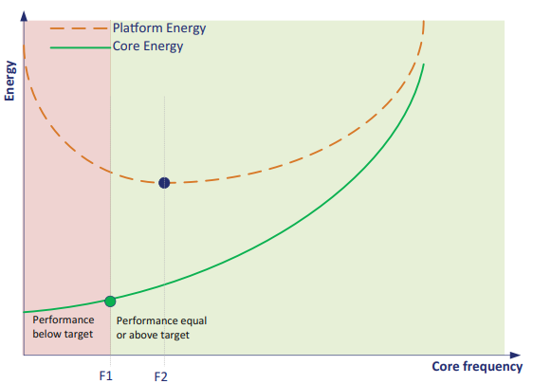
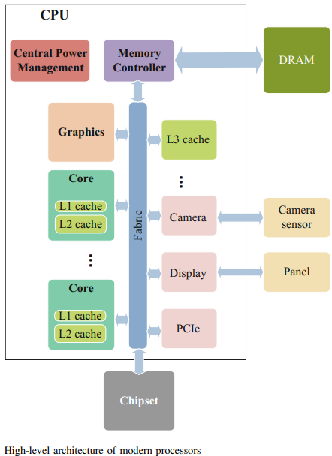
Energy Efficiency
Using tools like Intel Power Gadget and HWiNFO, the assessment observes power fluctuations across different workloads, understanding processor behavior and efficiency.
Analyzing air and liquid cooling, the study assesses heatsinks, fans, and liquid systems, evaluating thermal performance across diverse workloads.
Assessing power usage in gaming, video editing, and office tasks, the study evaluates the processor's energy efficiency and performance per watt.
Exploring Intel Speed Shift and AMD's Precision Boost, the study investigates intelligent power management, optimizing clock speeds and voltages efficiently.

Slide 19
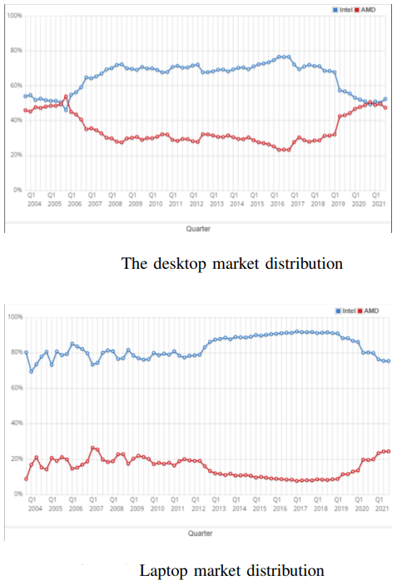
User preference and market
User preference and market share survey display AMD's rising popularity due to cost-effectiveness, core count, and Intel's retained base for performance, stability, and lower heat.

Slide 20
Future Improvements
Enhanced Energy Efficiency: Reducing power consumption while maximizing performance, particularly for mobile devices and laptops.
Increased Core Counts: Continuing the trend of adding more cores to handle parallel tasks and improve multitasking capabilities.
Improved Integrated Graphics: Elevating the quality of integrated GPUs to reduce the need for discrete graphics cards, especially in space-constrained systems.
Advancements in Microarchitecture: Refining the microarchitecture for greater speeds, reduced latency, and improved overall computational efficiency.
Smaller Process Nodes: Moving to smaller nanometer process nodes to pack more transistors into the same space, increasing performance and energy efficiency.
Better Thermal Management: Developing more advanced cooling solutions to manage heat dissipation, allowing for higher performance without overheating.

Slide 21
Conclusion
The study comprehensively compared Intel's Core and AMD Ryzen processors, assessing processing speed, energy efficiency, scalability, and microarchitectural innovations.
Utilized benchmarking tools, real-world application tests, and architectural analysis to connect theoretical knowledge with real-world performance metrics.
Findings indicate both Intel and AMD processors have strengths and weaknesses catering to diverse user needs.
Despite AMD's advancements, Intel processors still maintain a strong market position due to their established reputation for performance, stability, and compatibility across a wide range of applications and industries.
Energy efficiency comparisons leaned toward AMD processors, which generally showcased lower power consumption and heat generation in their operations compared to equivalent Intel processors.
AMD processors typically excel in multi-core performance.

Slide 22
References
C. N. Keltcher, K. J. McGrath, A. Ahmed and P. Conway, ”The AMD Opteron processor for multiprocessor servers,” in IEEE Micro, vol. 23, no. 2, pp. 66-76, March-April 2003, doi: 10.1109/MM.2003.1196116.
Platform 2015: Intel® Processor and Platform Evolution for the Next Decade Shekhar Borkar Pradeep Dubey Kevin Kahn David Kuck Hans Mulder Steve Pawlowski Justin Rattner.
TESTING AMD RYZEN MICROPROCESSOR AND ITS ENERGY EFFICIENCY research, vol.22, 2021, International Journal ISSN 1314- 6289 Daniel R. Denev.
Keltcher, C. N., McGrath, K. J., Ahmed, A., & Conway, P. (2003). ”The AMD Opteron processor for multiprocessor servers.” IEEE Micro, 23(2), 66-76.
Borkar, S., Dubey, P., Kahn, K., Kuck, D., Mulder, H., Pawlowski, S., & Rattner, J. (2015). ”Platform 2015: Intel® Processor and Platform Evolution for the Next Decade.” Shekhar Borkar Pradeep Dubey Kevin Kahn David Kuck Hans Mulder Steve Pawlowski Justin Rattner
Martinez, E., Lee, A., & Wang, J. (2020). ”AMD EPYC: A Study on Server Performance and Scalability.” IEEE Transactions on Servers and Data Centers
Patel, G., & Kumar, S. (2017). ”Performance and Power Efficiency Analysis of ARM-based Processors.” Journal of Low Power Electronics.

Slide 23

Thank You

